Slide 1
Web basics-JavaScript
Lesson 1: Introduction to JavaScript

Slide 2

Lesson Objectives
To understand the following topics:
Basic Concepts of JavaScript
Embedding JavaScript in HTML

Slide 3
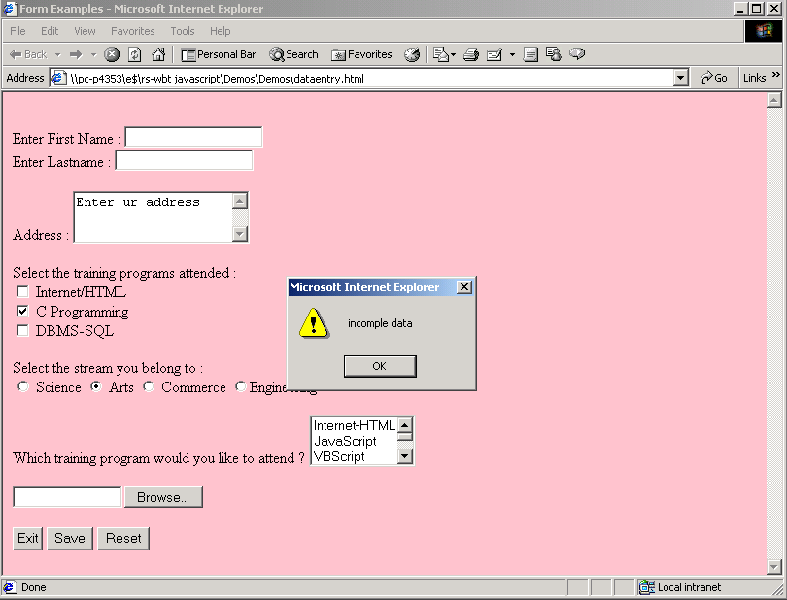
1.1: Basic Concepts of JavaScript Basic Concepts of JavaScript
JavaScript is the scripting language of the Web
JavaScript is used putting dynamic content into HTML page and for client side validation
Notes:
Basic Concepts of JavaScript
JavaScript History :
Web pages made using only HTML are somewhat static with no interactivity and negligible user involvement.
HTML tags are just instructions on document and the display of the document is dependent on the browser.
Interactive pages cannot be built with only HTML, we need a programming language.
So Netscape came out with a client-side language called as JavaScript.
What is JavaScript?
JavaScript is THE scripting language of the Web.
JavaScript is used in Web pages to add functionality, validate forms, detect browsers, and much more.
JavaScript is the most popular scripting language on the internet and works on all major browsers available like IE, Firefox, Chrome etc..
Need of JavaScript:
For putting dynamic content into an HTML Page.
For client side Validation.
For storing and retrieving client's information in the form of Cookies.

Slide 4
1.1: Basic Concepts of JavaScript Overview
JavaScript is Netscape's cross-platform, object-based scripting language
JavaScript code is embedded into HTML pages
It is a lightweight programming language
Client-side JavaScript extends the core language by supplying objects to control a browser and its Document Object Model
Server-side JavaScript extends the core language by supplying objects relevant to running JavaScript on a server
Notes:
What is JavaScript?
JavaScript is Netscape's cross-platform, object-based scripting language. Core JavaScript contains a core set of objects, such as Array, Date, and Math, and a core set of language elements such as operators, control structures, and statements. Core JavaScript can be extended for a variety of purposes by supplementing it with additional objects; for example:
Client-side JavaScript extends the core language by supplying objects to control a browser (Navigator or another web browser) and its Document Object Model (DOM). For example, client-side extensions allow an application to place elements on an HTML form and respond to user events such as mouse clicks, form input, and page navigation.
Server-side JavaScript extends the core language by supplying objects relevant to running JavaScript on a server. For example, server-side extensions allow an application to communicate with a relational database, provide continuity of information from one invocation to another of the application, or perform file manipulations on a server.
JavaScript lets you create applications that run over the Internet. Client applications run in a browser, such as Internet Explorer/Firefox, and server applications run on a server, such as Netscape Enterprise Server. Using JavaScript, you can create dynamic HTML pages that process user input and maintain persistent data using special objects, files, and relational databases.

Slide 5
1.1: Basic Concepts of JavaScript > 1.1.2: How does it work? How does it work ?
When a JavaScript is inserted into an HTML document, and the HTML document is opened on a web browser:
The browser will read the HTML .
It interprets the JavaScript .
It executes the JavaScript immediately, or at a later event i.e could be based on user action or system event.
Notes:
How does JavaScript work?
When a JavaScript is inserted into an HTML document, the Internet browser will read the HTML and interpret the JavaScript. The JavaScript can be executed immediately, or at a later event.

Slide 6
1.1: Basic Concepts of JavaScript Why use JavaScript?
JavaScript:
Provides HTML designers a programming tool
Puts dynamic text into an HTML page
Reacts to events
Reads and writes to HTML elements
Can be used to validate data
Notes:
Why use JavaScript?
JavaScript gives HTML designers a programming tool :
JavaScript is a simple scripting language which can be used by HTML authors who essentially are not familiar with programming. Hence the HTML authors can easily put small JavaScript code snippets into HTML pages.
JavaScript can put dynamic text into an HTML page : A simple HTML text which displays static content such as <h1>Patni</h1> can be written in JavaScript to display dynamic content using document.write("<h1>" + orgname + "</h1>")
JavaScript can react to events : A JavaScript can be set to execute when some action takes place, like when a page has finished loading or when a user clicks on an HTML element.
JavaScript can reads and writes HTML elements: A JavaScript can read values of HTML elements and also write/change the content of an HTML element.
JavaScript can be used to validate data : Client side validation can easily taken care of by JavaScript. This reduces the burden on the server.
Apart from this JavaScript can also be used to create cookies which is stores and retrieves information about the user preferences. JavaScript can also be used to detect browser which helps in loading a page specifically designed for the browser.

Slide 7
1.2: Embedding JavaScript in HTML Embedding JavaScript in HTML
The <SCRIPT> tag
<SCRIPT>
JavaScript statements …
</SCRIPT>
Specifying the javascript version
<SCRIPT LANGUAGE=“JavaScript 1.2”>
Notes:
Embedding JavaScript in HTML:
The <SCRIPT> tag is an extension to HTML that can enclose any number of JavaScript statements as shown on the slide.
A document can have multiple <SCRIPT> tags, and each can enclose any number of JavaScript statements.
The Script tag has the following attributes:
Language – This attribute specifies the scripting language. It can have values like VBScript, JavaScript. Optionally you can also specify the scripting language version as mentioned on the slide.
Type – Specifies the MIME type of the scripting language
Src – This attribute is for specifying the path and filename of an external .js file which contains the script code.
Some browsers may not support JavaScript and the JavaScript code is displayed as page content. To prevent this, the HTML comment should be used which will hide the JavaScript as shown on the slide. Note the two forward slashes at the end of the comment line. This is JavaScript comment symbol which prevents JavaScript from executing the -- > tag.
Note that Javascript is a case-sensitive scripting language.

Slide 8
Embedding JavaScript in HTML(contd)
Hiding Scripts with Comment tags
<script type=“text/javascript”>
<!--
some statements …
// -->
</script>

Slide 9
Embedding JavaScript in HTML (Contd.)
Using Quotation Marks
document.write(“<A HREF=‘A.HTML’>Link to next page”)
Specifying alternate content with the NOSCRIPT tag
<NOSCRIPT>
Your browser has JavaScript turned off.
</NOSCRIPT>
Notes:
Embedding JavaScript in HTML (contd..):
Whenever you want to indicate a quoted string inside a string literal, use single quotation marks (') to delimit the string literal. This allows the script to distinguish the literal inside the string. In the following example,
The attribute values are in double quotes, but in the call to the function myfunc the argument passed is a string which is enclosed in a single quotes.
Use the <NOSCRIPT> tag to specify alternate content for browsers that do not support JavaScript. HTML enclosed within a <NOSCRIPT> tag is displayed by browsers that do not support JavaScript; code within the tag is ignored by browser. In case, if the user has disabled JavaScript from the Advanced tab of the Preferences dialog, the browser displays the code within the <NOSCRIPT> tag.
<INPUT TYPE="button" VALUE="Press Me" onClick="myfunc('astring')">.

Slide 10
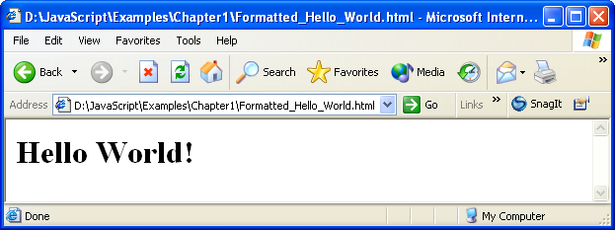
Embedding JavaScript in HTML (Contd.)
Including text-formatting features
<!DOCTYPE html>
<html>
<head> </head>
<body>
<script type="text/javascript">
document.write("<H1>Hello World!</H1>")
</script>
</body>
</html>

Slide 11
1.3: Embedding JavaScript in HTML
Where to Write JavaScript?
Html Page
Head Section
Body Section
External File
<script language=
“JavaScript”>
</script>
<head></head>
<body></body>
External file
//script statement
Notes:
Embedding JavaScript in HTML: Where to Write JavaScript?
Physically the script code can be placed at three different places in the html file.
Head Section: If you want the Scripts to be executed when they are called, or whenever a user action happens, put script tag in the head section.
Body Section : If you want the Scripts to be executed when the page loads then put script tag in the body section
External File : If you want to run the same JavaScript on several pages, without having to write the same script on every page, you can write a JavaScript in an external file.

Slide 12
1.3: Where to Write JavaScript? JavaScript in Head Section
Syntax
<!DOCTYPE html>
<html>
<head>
<script type="text/javascript">
function message()
{
alert("This alert box was called with the
onload event")
}
</script>
</head>
<body onload="message()">
</body>
</html>
Notes:
Where to Write JavaScript? In the Head Section:
Head Section : JavaScripts in an HTML page will be executed when the page loads. This might always not be the case. Sometimes we want to execute a JavaScript when an event occurs, such as when a user clicks a button. In such scenarios, we can put the script inside a function. Scripts that contain functions go in the head section of the document. Then we can be sure that the script is loaded before the function is called.
The example shown on the slide shows the following output:
Figure 1.3 Output of Example 1.3 (Script_in_Head.html)

Slide 13
1.3: Where to Write JavaScript? JavaScript in Body Section
Syntax
<!DOCTYPE html>
<html>
<head>
<title>script tag in body</title>
</head>
<body >
<script language=“javascript">
document.write("this message is written when the page loads“)
</script>
</body>
</html>
Notes:
Where to Write JavaScript? In the Body Section:
Body Section : Execute a script that is placed in the body section. The example on the slide shows script written in the body section.
And it produces this output:
Figure 1.4 Output of Example 1.4 (Script_in_body.html).

Slide 14
1.3: Where to Write JavaScript? JavaScript in External File
Content of common.js
var msg
msg=“<h1>declared in external js file</h1>"
HTML page using the external script file
<!DOCTYPE html>
<html>
<head><title>script tag in external file</title>
<script src="common.js">
<!– no javascript statements can be written here→
</ script>
</head>
<body> <script>
document.write("display value of a variable”+msg)
</script> </body>
</html>
Notes:
Where to Write JavaScript? In External File:
The example on the slide demonstrates how to write JavaScript code in an external file. The extension of the external file has to be .js and the it does not contain the scrip tag.

Slide 15
Demo
Hello.html
Head_section.html
Extern_file.html
Comm.js
Var_ex.html

Slide 16

Lab
Basic concepts of JavaScript

Slide 17

Summary
JavaScript is the client side scripting language
When a JavaScript is placed inside a web page, the browser loads the page & built-in interpreter reads the JavaScript code & execute
JavaScript is used in Web pages for
Validating client side data.
Putting dynamic content into an HTML page.
Storing client’s information in the form of Cookies.

Slide 18

Review Question
Question 1: JavaScript, a scripting language, is:
Option 1: Cross-platform, object-oriented
Option 2: Cross-platform, object-based
Option 3: Non cross-platform, object-oriented
Question 2:The <SCR> tag is an extension to HTML that can enclose any number of JavaScript statements.
True/False
Question 3:HTML enclosed within a ___________ tag is displayed by browsers that do not support JavaScript.
Notes:
Answers
Option 2
False
noscript

Slide 19
Review Question: Match the Following
Embed JavaScript in an HTML document as statements and functions within a tag
To specify alternate content for browsers that do not support JavaScript
Feature of JavaScript
JavaScript can be written in these sections
<NOSCRIPT>
Head, Body
SCRIPT
Head, Body JavaScript can be used to validate data
Notes:
Answers
3
1
4
2

